Slide 1
Mental Model-II
Lec 3

Slide 2
Outline for Lecture
01
Revision
02
Components
03
Examples

Slide 3

MENTAL MODEL

Slide 4

MENTAL MODEL
The Idea of
how a product works
in the mind of the
user
HCI

Slide 5
Revision
Good Designs are
developed according to
user’s
Mental Model
HCI

Slide 6

How will users perceive
the
product
HCI

Slide 7
Think of 4 major
components of
Mental Model
HCI

Slide 8


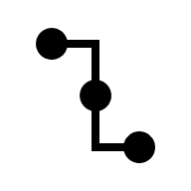

Affordance
1st
Constraints
2nd
Mapping
3rd
Causality
4th
HCI

Slide 9
Affordance
1st
Constraints
2nd
Mapping
3rd
Causality
4th
Possible actions on a product
Limits on those possible actions
How an action on a control changes the product
Which Control is related to which part of product
HCI

Slide 10
Affordance

Slide 11
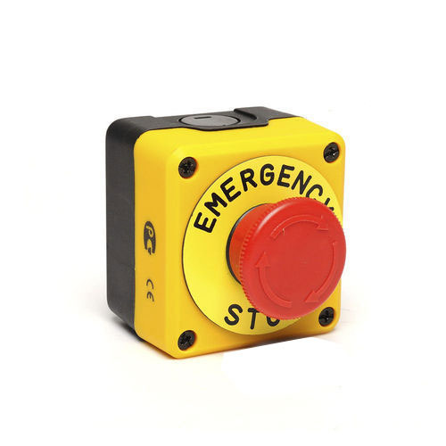
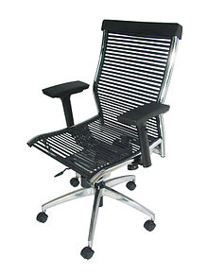
AFFORDANCE
Range of possible actions by a user on an object
A button affords pressing
A chair affords sitting/support. What else ??

Slide 12
Affordance is a relationship
To be effective affordances have to be perceivable
Real vs Perceived

Slide 13
What would be the affordance of :
A Door knob
A slot
Glass slab

Slide 14
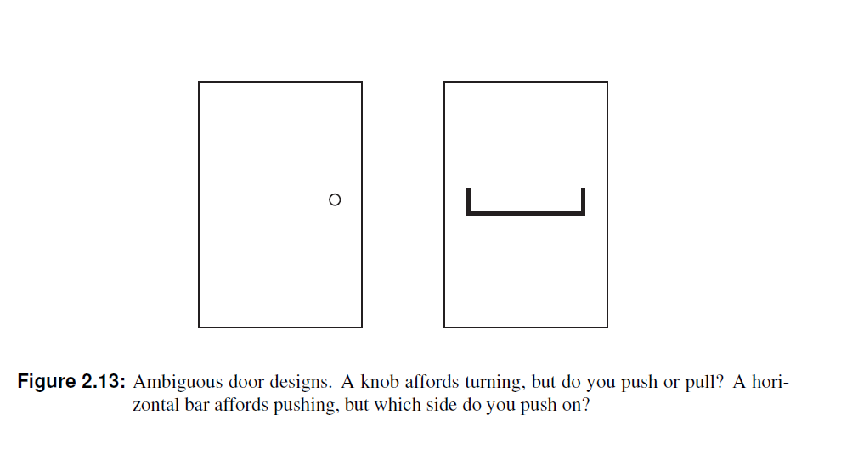
Examples

Slide 15
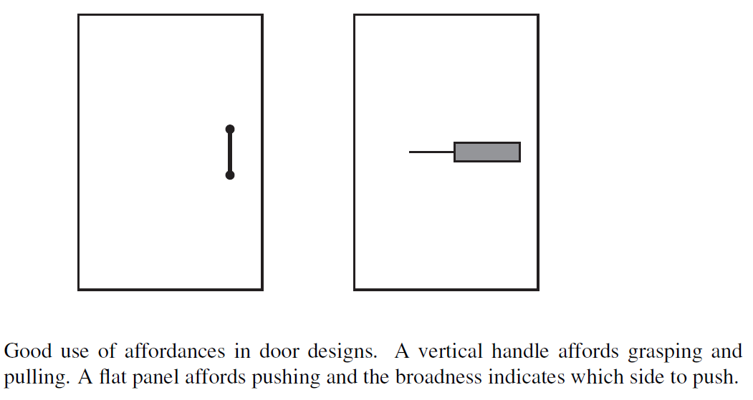
Contd…

Slide 16
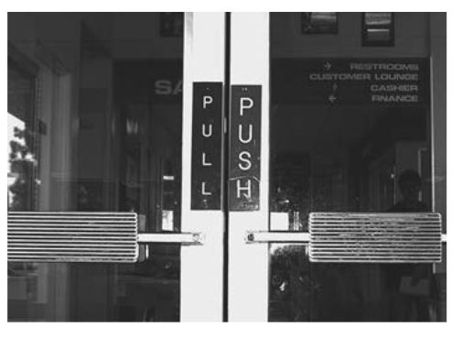
Issue ?
Taken from Design of Everything by Dan Norman

Slide 17
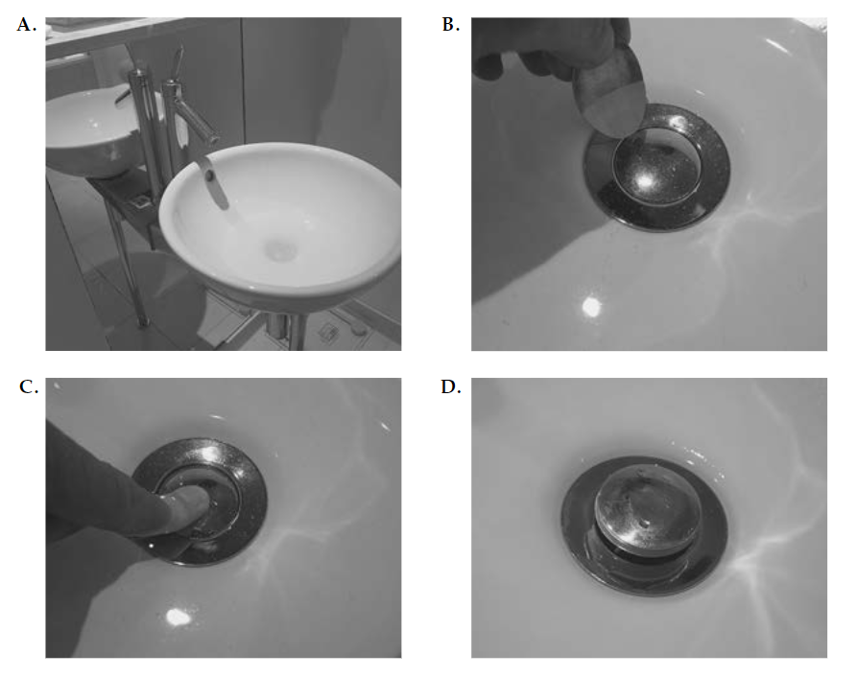
Issue ?
Taken from Design of Everything by Dan Norman

Slide 18
Constraints

Slide 19
Constraints
Affordance represents possibilities
Constraints represent limitations (on actions)
Useful in controlling complexity

Slide 20
Simple Examples
A flip switch
Mouse scroll wheel
Capacitive Touch screen

Slide 21
Discussion
What are the constraints of:
A polarized glass
A door knob

Slide 22
Constraints
Physical
Semantic
Cultural
Logical

Slide 23
Physical
Limits on physical actions
Semantic
Rely on our knowledge of situation and the world
Cultural
Rely upon accepted cultural conventions
Logical
Exploit logical relationship

Slide 24
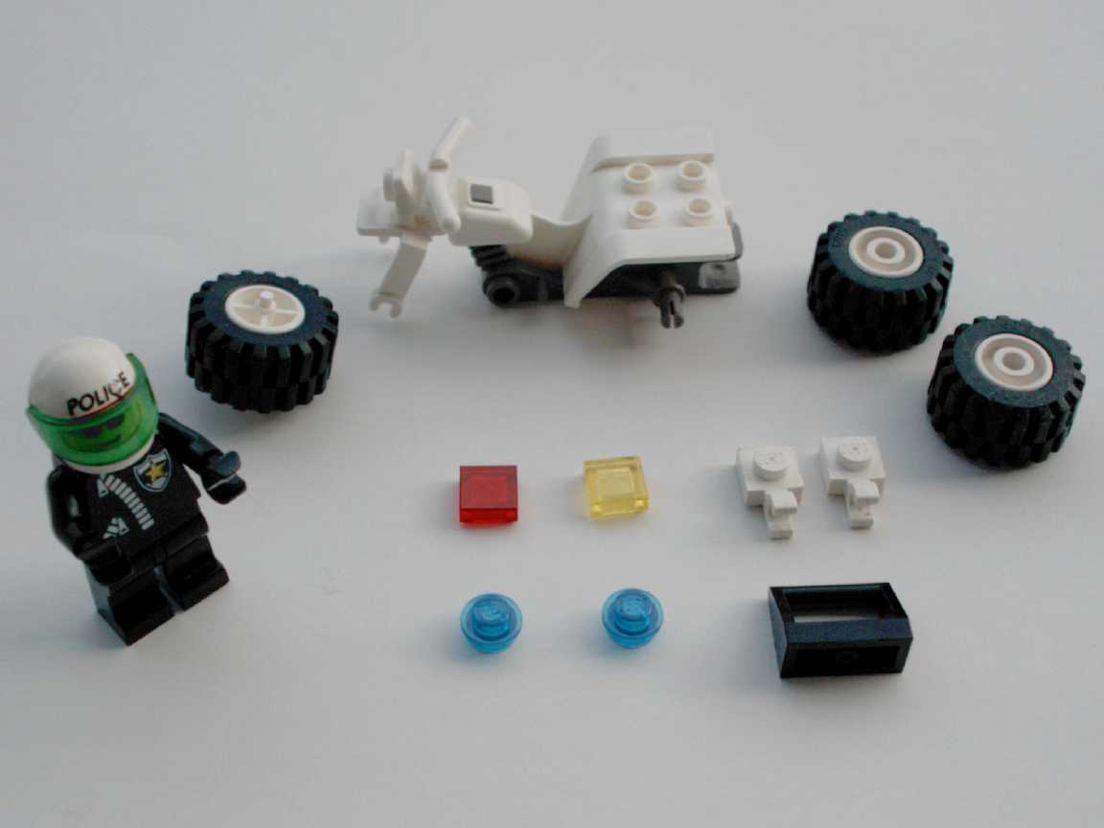
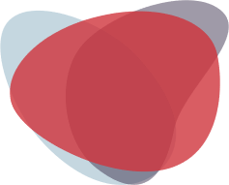
Example
Simplicity by constraints
12 piece lego set

Slide 25
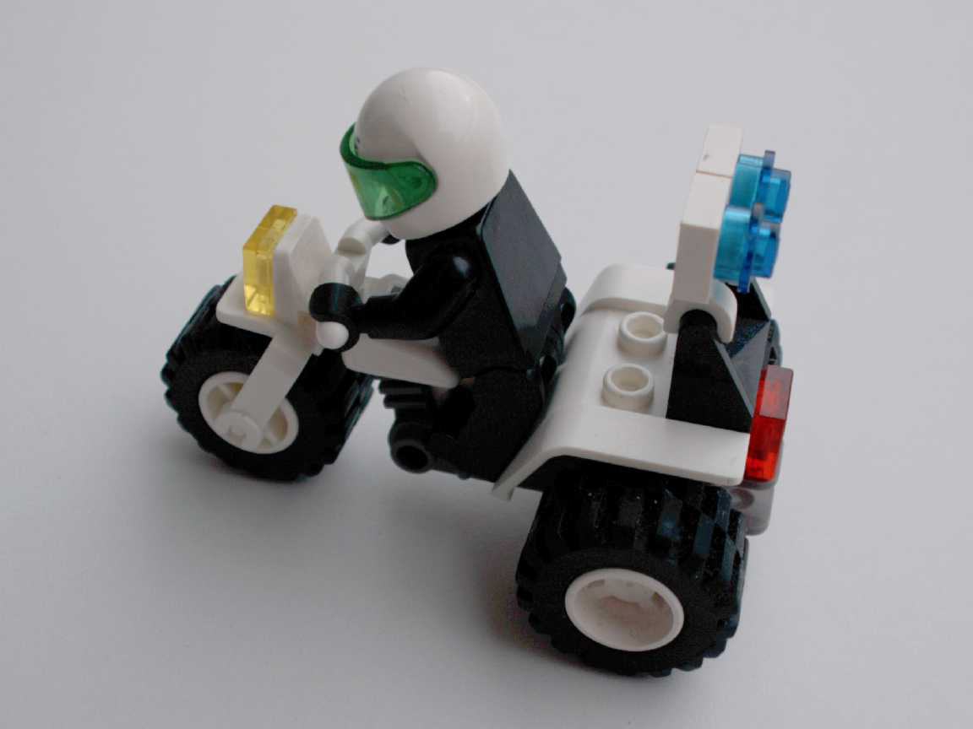
Example
Physical: Front wheel only fits in one place.
Semantic: The rider sits on the seat facing forward.
Cultural: Red is a rear light, yellow a front light.
Logical: Two blue lights, two white pieces, probably go together.

Slide 26
Mapping

Slide 27
Mapping
Relationship b/w elements of a system
e.g. Which switch controls which light in a room
Useful in designing control layout

Slide 28
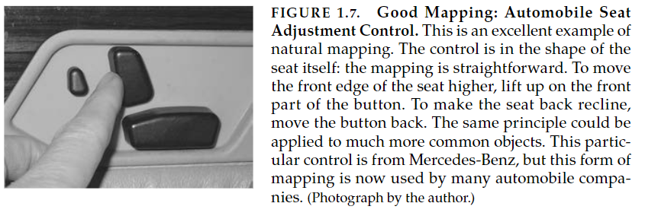
Good Mapping
Taken from Design of Everything by Dan Norman

Slide 29
Spatial correspondence
between
the layout of the controls
and
device being controlled ,
makes using the device easier

Slide 30
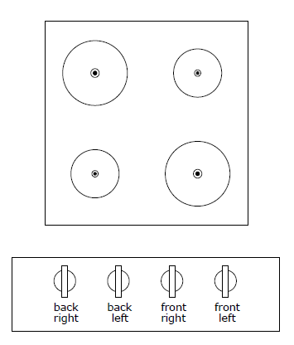
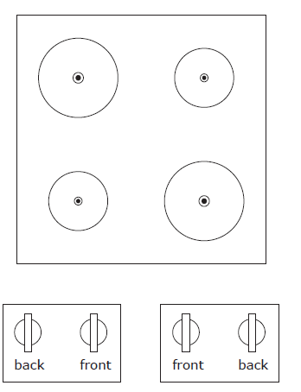
Cooking Stove’s design taken from lecture notes by Keith Andrews

Slide 31
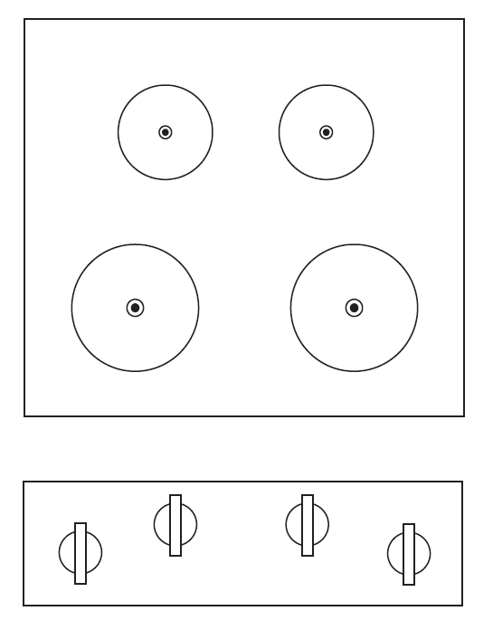

Slide 32
Contd…
Other Examples
Improve Understanding ?
Follow physical analogies and cultural standards
Notes:
1. Steering wheels and tyres, controls of tanks , cranes , bulldozers and wheel chairs…. Volume control on remote -> upper button increase
3.Give examples here …. Like up and right means more and likewise left and down means less → sliders in apps
A red button may indicate “stop” or “emergency” ; a green button may indicate “go” or “resume”.

Slide 33
Causality

Slide 34
Causality
Result (cause) of an action by user
Relationship b/w 2 events
Cause and effect

Slide 35
Causality
Pressing gas pedal increases speed
Flipping a switch down turns on a light
Clicking X button closes an application on computers

Slide 36
Causality
False Causality
1. Coincidental
2. Invisible effects
Proper Feedback helps reduce confusion

Slide 37
Conclusion

Slide 38
How will users perceive
the
product
HCI

Slide 39
Think of 4 major
components of
Mental Model
HCI

Slide 40
Affordance
1st
Constraints
2nd
Mapping
3rd
Causality
4th
HCI

Slide 41
Assignment Questions
Reading : pg. 10-35 from Design of Everything by Dan Norman
The text above mentions 2 other components of mental model , signifiers and feedback . Explain them in your own words?
The text above , in one of the examples ,mentions a confusion the author faced while dealing with his refrigerator. Where do you think the designer of that product failed ?
Pick a product of your daily use, and note down its affordances , constraints , mapping and causality.

Slide 42
The End

